Slide 1
Binary Search Trees (BST) and Balanced BST
Charles W. Kann

Slide 2
Overview
Dictionary
SortedArray
  Accessed via key (not index)
  Comparator or Comparable provides invariant
  Best, Average, and Worst Cases
Binary Search Tree (BST)
  Binary Tree where left is less-then, right is greater –then
  No duplicates or null keys
  Operations
    Add
    Merge
    Contains, Retrieve
    Remove

Slide 3
Overview (Continued)
Balanced Binary Trees
  Adelson-Velskii and Landis (AVL) trees
2-3 Trees and B-trees

Slide 4
Dictionary
Collection used to store data (not a utility) that is accessed via a key, not an index.
Key is determined by either a Comparator (if supplied) or Comparable (if no Comparator).

Slide 5
Definition of Dictionary
public interface Dictionary {
public void changeComparator(Comparator<E> comparator);
public void add(E element);
public void add(Collection<E> elements) throws DataStructureException;
public void add(E[] elements);
public void merge(Dictionary<E> elements) throws DataStructureException;
public boolean contains(E element );
public E retrieve(E element);
public E remove(E element);
///////////////
// findMin, findMax
// Iterator returns an inorder tree walk
}

Slide 6
Notes:
Change comparator requires that the entire dictionary be rewritten.
Merge is different than add for a Collection because it can in some cases (not always) be implemented faster using a Merge algorithm.

Slide 7
Simplest case – Sorted Array List (flat data structure)
Method | Big O | Comment
changeCompartor | O(nlogn) | Sort the array
add | O(n) | Find element and move all successors
add(Collection<E>) add(E[]); | O(nlogn) | Add the elements to end, and re=sort
merge(Dictionary<E>) | O(n) | Use merge algorithm
contains retrieve | O(logn) | Binary Search
remove | O(n) | Find element and move all successors

Slide 8
Binary Search Tree (BST)
A BST is a binary tree of nodes with the property that all nodes with a key less than the current node are in a subtree that is contained in the left child of the node, and all nodes with a key greater than the current node are in a subtree contained in the right child of the node.
No duplicates or null values are allowed in the key.
A BST is a complete ordering.

Slide 9
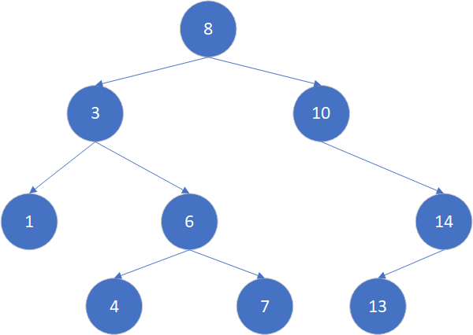
BST - Example
Topic :
Not a flat data structure
  Preorder walk – 8, 3, 1, 6, 4, 7, 10, 14, 13
  Inorder walk – 1, 3, 4, 6, 7, 8, 10, 13, 14 (only one that makes sense)
  Post order walk – 1, 4, 7, 6, 3, 13, 14, 10, 8

Slide 10
BST – Contains (find) 7
Topic :
  7 < 8, walk left
  7 > 3, walk right
  7 > 6, walk right
  7 = 7, return true

Slide 11
BST – Contains (find) 2
Topic :
  2 < 8, walk left
  2 < 3, walk left
  2 > 1, walk right
  Node = null, return false

Slide 12
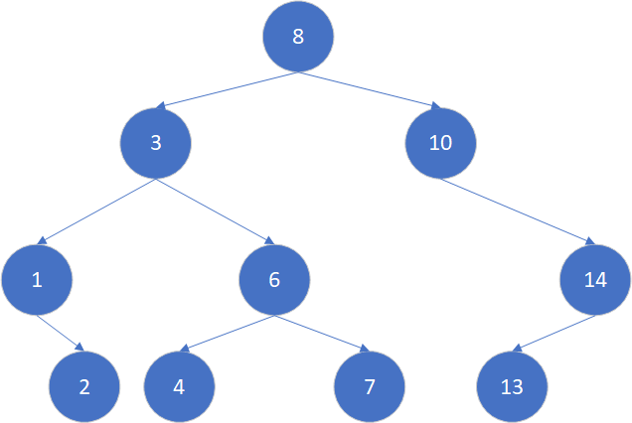
BST – add 2

Slide 13
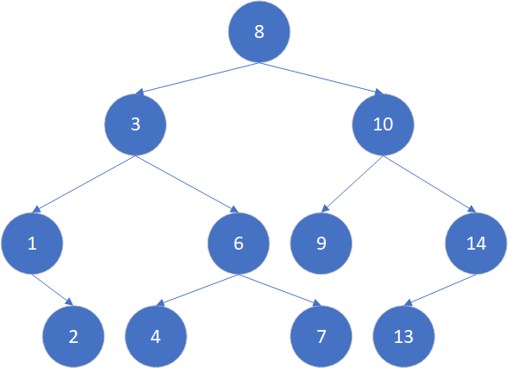
BST – add 9

Slide 14
Find Max (or Min) child
Find max
  Go right as far as possible
Find min
  Go left as far as possible

Slide 15
Delete
Find node with key
  If the node has no children, delete the node.
  If the node has one child, replace it with it’s child
  If the node has 2 children
    Find the min child (or max child).
      This node by definition has 0 or 1 child (why)
      This node can be found by starting left and walking to the right most descendent, or starting right and walking to the left most descendant. (why?)
    Copy the value to deleted node
    Remove node as above.

Slide 16
Big-O of operations (Assuming balanced tree)
Method | Big O | Comment
changeCompartor | O(nlogn) | Re-build tree
add | O(logn) | Place item in tree
add(Collection<E>) add(E[]); | O(nlogn) | Add elements 1 by 1
merge(Dictionary<E>) | O(nlogn) | Add elements 1 by 1
contains retrieve | O(logn) | Walk tree
remove | O(logn) | Find element. Remove it. At worst (2 children) find min (or max) and remove it.

Slide 17
Degenerative Case
Add items in order 1, 2, 3, 4, 5, 6, 7, 8
What is created is an expensive linked list
For random input, this is unlikely, but needs to be handled.
Balanced BST using AVL (or Red-Black Trees)

Slide 18
AVL tree
Tree is not perfectly balanced, but all subtrees have a height within 1 of each other.
Keep track of the height of every node. Add the node, and add 1 if necessary to the height of the each node as you pass through it.
If the subtrees of a node have a height difference greater than 1, rotate the nodes
If value to insert between the node and the subtree on the current path, do a double rotation.
  Rotate child on path
  Rotate node

Slide 19
AVL information
https://www.cs.usfca.edu/~galles/visualization/Algorithms.html
  Note: This sites answer is correct, but the algorithm does not do double rotations
https://visualgo.net/bn/bst
https://www.cs.auckland.ac.nz/software/AlgAnim/AVL.html
https://en.wikipedia.org/wiki/AVL_tree

Slide 20
2-3 Tree
https://www.cs.usfca.edu/~galles/visualization/BTree.html
https://en.wikipedia.org/wiki/2%E2%80%933_tree

Slide 21
New Slide
We say that an internal node is a 2-node if it has one data element and two children.
We say that an internal node is a 3-node if it has two data elements and three children.
We say that T is a 2–3 tree if and only if one of the following statements hold:
T is empty. In other words, T does not have any nodes.
T is a 2-node with data element a. If T has left child L and right child R, then
  L and R are non-empty 2–3 trees of the same height;
  a is greater than each element in L; and
  a is less than or equal to each data element in R.
T is a 3-node with data elements a and b, where a < b. If T has left child L, middle child M, and right child R, then
  L, M, and R are non-empty 2–3 trees of equal height;
  a is greater than each data element in L and less than or equal to each data element in M; and
  b is greater than each data element in M and less than or equal to each data element in R.

Slide 22
Higher order trees

Slide 23
B trees and B+ trees
https://stackoverflow.com/questions/870218/differences-between-b-trees-and-b-trees

Slide 24
AVL visualization
https://visualgo.net/bn/bst
Correct answer, wrong visualization
  https://www.cs.usfca.edu/~galles/visualization/AVLtree.html

